Slide 1

Mercedes-TPOT Project: Predicting Outcomes using Data
Using AutoML to predict Mercedes-Benz car production outcomes

Slide 2

Introduction
Mercedes-TPOT project: predicting production outcomes using Mercedes-Benz data.
1
TPOT
2
Objective
Tree-based Pipeline Optimization Tool
Predicting outcomes using Mercedes-Benz car data

Slide 3
Project Motivation
Importance of predictive analytics in the automotive industry.
Predictive Analytics
AutoML
Helps to improve efficiency and reduce costs
AutoML tools like TPOT can automate the process of building machine learning models

Slide 4

Dataset Description
Data source: Mercedes-Benz manufacturing data.
Features
Production Processes
Resource Usage
Target
Production Delays
Resource Inefficiencies

Slide 5

Literature Review
Key insights from previous research on AutoML.
1
AutoML Overview
He et al. (2019): AutoML: A Survey of the State-of-the-Art.
2
Predictive Modeling in Automotive
Chakraborty et al. (2020): Highlights the importance of ML in optimizing automotive processes.

Slide 6

Methodology
Data preprocessing, feature engineering, and scaling.
Data Preprocessing
1
Handling missing data, feature engineering, and scaling.
2
TPOT Process
Automated selection of the best machine learning pipeline.
Algorithms Used
3
Random Forest, Gradient Boosting.

Slide 7
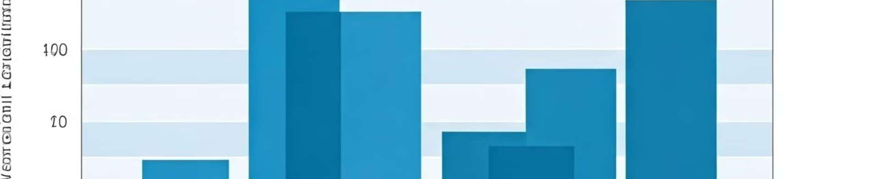
Results
Model performance: accuracy, F1-score.
Selected Pipeline
Accuracy
Evaluation Metrics
A combination of Random Forest and Gradient Boosting algorithms
The model achieved high accuracy in predicting production outcomes.
Used accuracy, F1-score, and other relevant metrics to evaluate model performance.

Slide 8
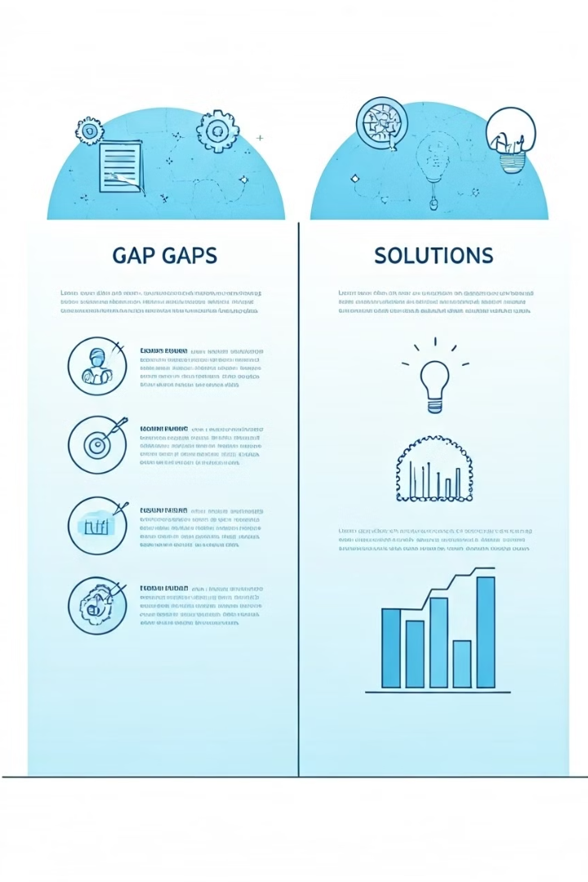



GAP Analysis
Identify gaps and plan improvements.
Limited Dataset Diversity
Expand the dataset with more diverse data points.
Over-reliance on Default Hyperparameters
Perform hyperparameter tuning to optimize model performance.
Focus on Accuracy Only
Explore and use additional evaluation metrics, such as precision, recall, and AUC.

Slide 9

Conclusion & Next Steps
TPOT has helped optimize predictions.
1
Hyperparameter Tuning
Fine-tune the model's parameters for better performance.
2
Expand the Dataset
Increase the size and diversity of the data for better generalization.
3
Explore Different Evaluation Metrics
Include additional metrics to get a more comprehensive understanding of the model's performance.

Slide 10

References
List key references.
He, X., Zhao, K., & Chu, X. (2019). "AutoML: A Survey of the State-of-the-Art."
Chakraborty, P., Sarkar, A., & Mukherjee, A. (2020). "Predictive Modeling in Automotive Sector."

